Slide 1

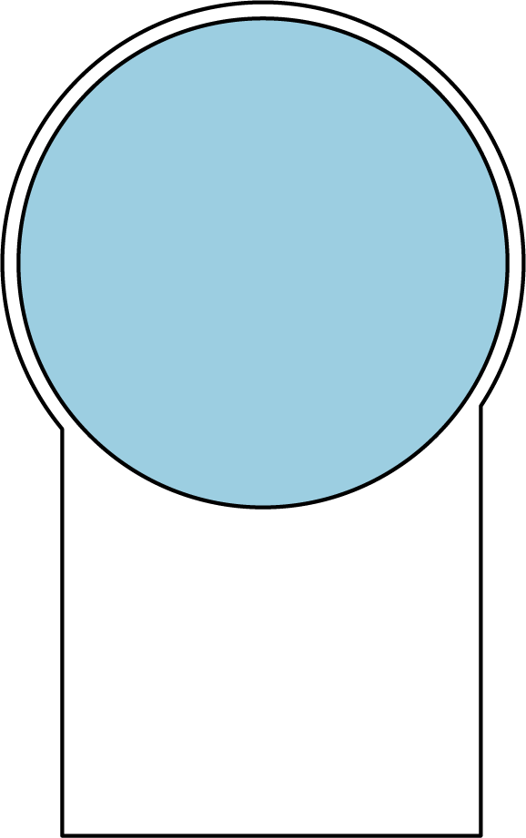
C a l m . i o
Fang Fang Patrick Lai Yani Mai Oliver Moldow Tonya Nguyen

Slide 2


DESIGN
INTENT
Mental health challenges are on the rise
Notes:
Yani

Slide 3


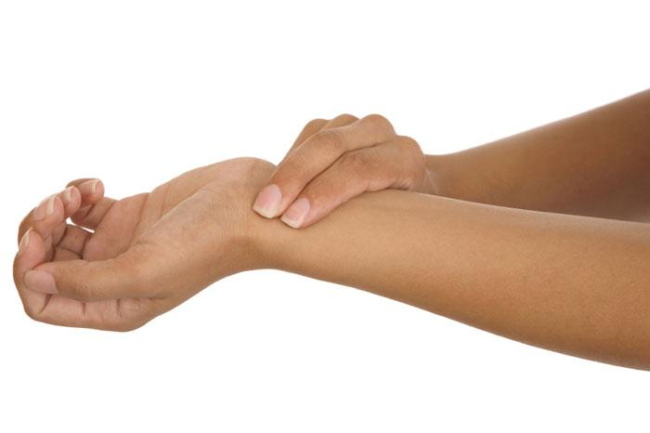
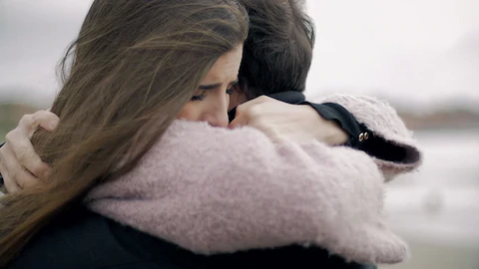

Interviews and studies lead us to a variety of coping mechanisms
Notes:
Yani
What to know about anxiety
https://www.medicalnewstoday.com/articles/323454.php

Slide 4

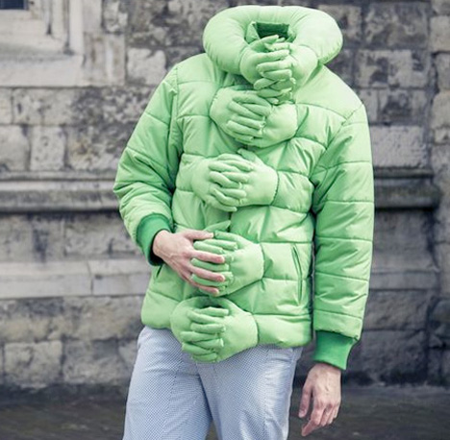
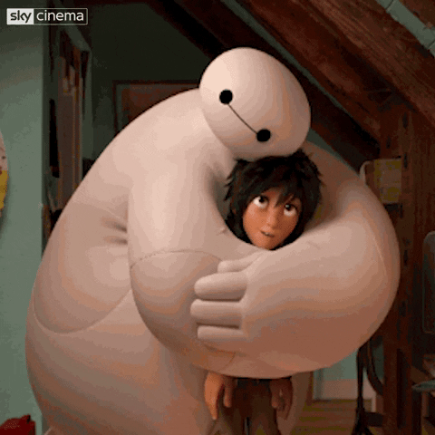
Inspiration
Notes:
Yani

Slide 5
Related
Works
Notes:
patrick

Slide 6
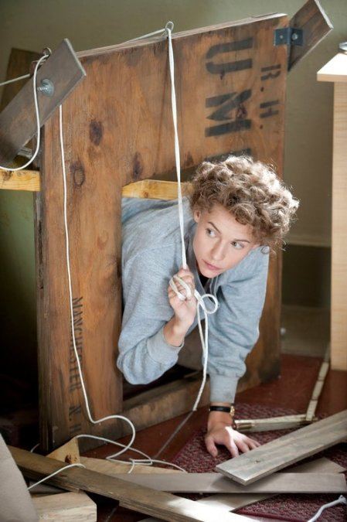
Temple Grandin’s Hug Box
Based off cattle squeeze chutes
Support hypersensitive individuals with gentle pressure
Proven to reduce tension and anxiety, especially in people with autism
Notes:
patrick

Slide 7
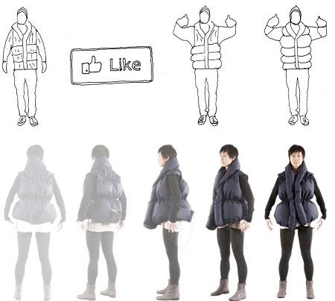
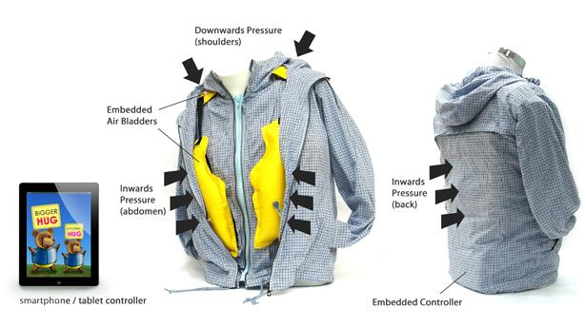
Hugging Jackets
Like-A-Hug Jacket
Brings people closer together despite physical distance
Hugs users in response to Facebook likes
T. Jacket
Sensors indicate when the child is anxious and informs guardian
App sends controlled hugs
Notes:
patrick

Slide 8
Design Goals
We found current coping methods, obvious to observers, hard to access quickly and remotely, and expensive.
In contrast, we wanted to create a discrete, easy to trigger, and reliable support mechanism.

Slide 9
PROCESS
Notes:
oliver

Slide 10
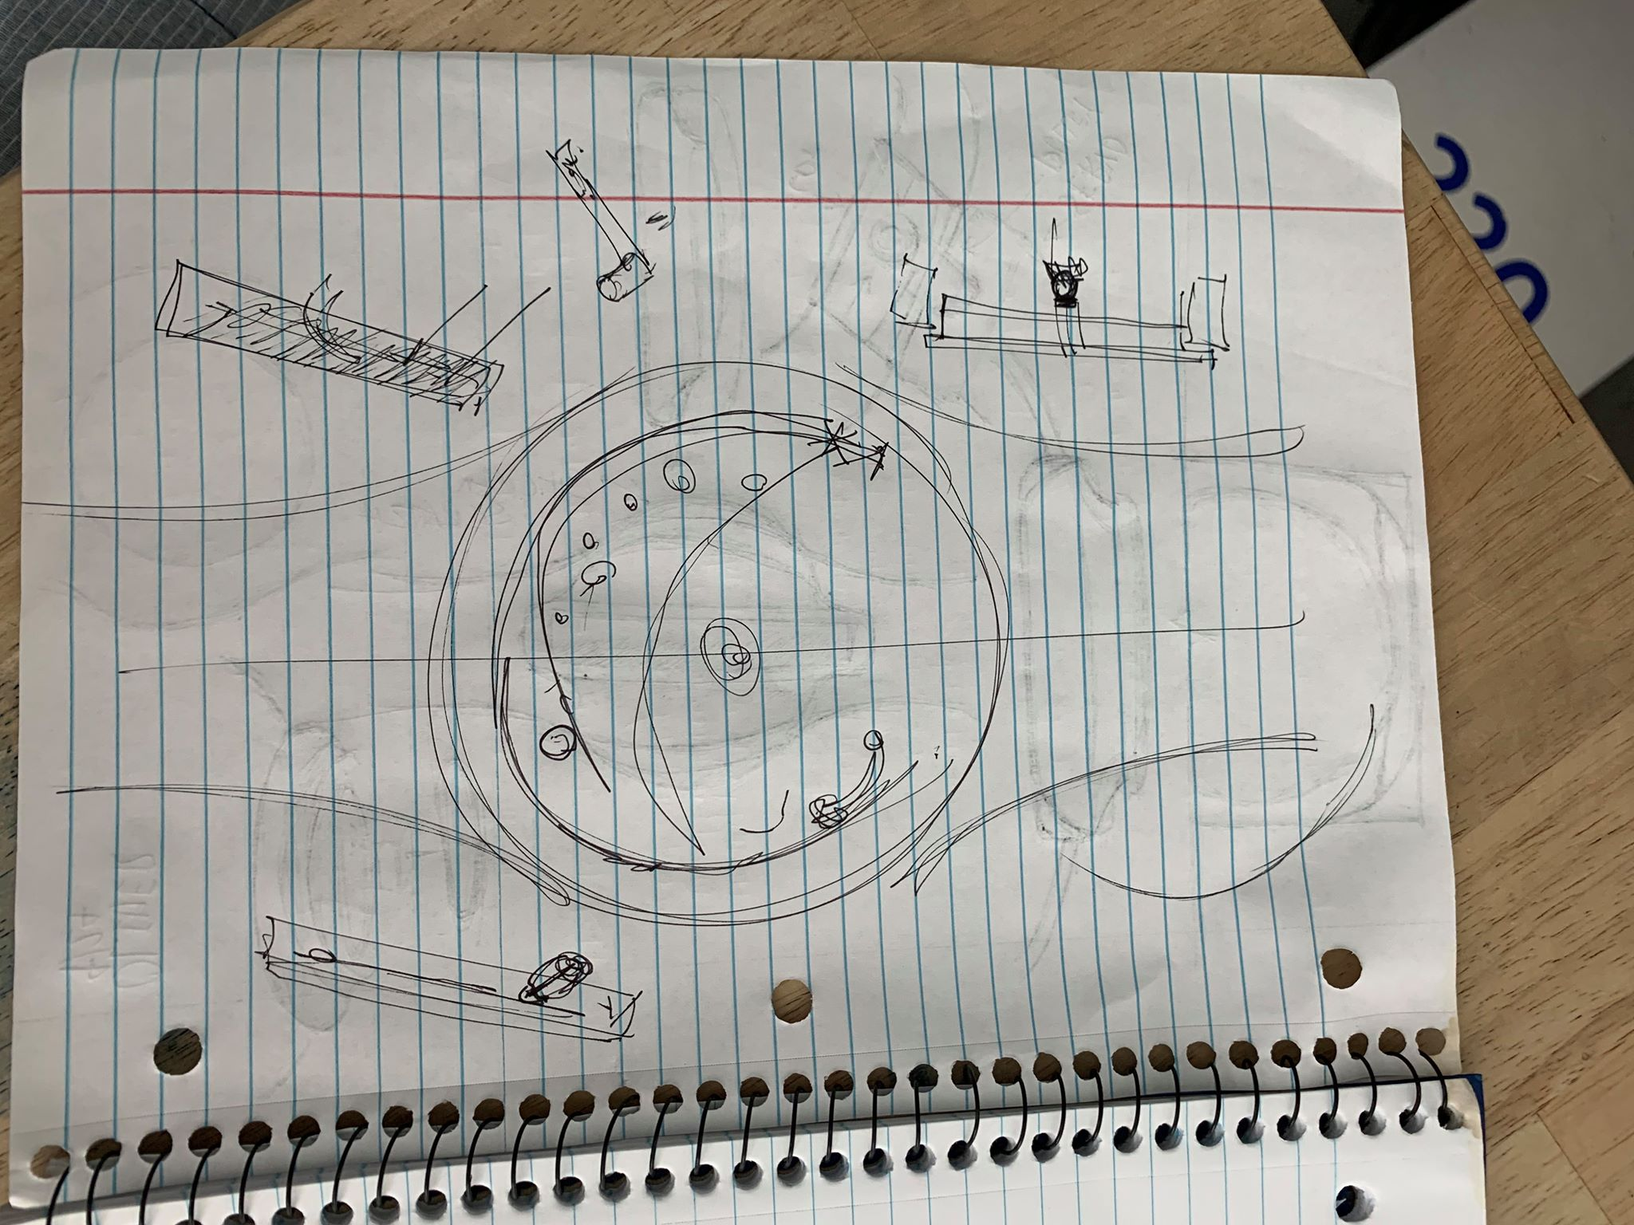
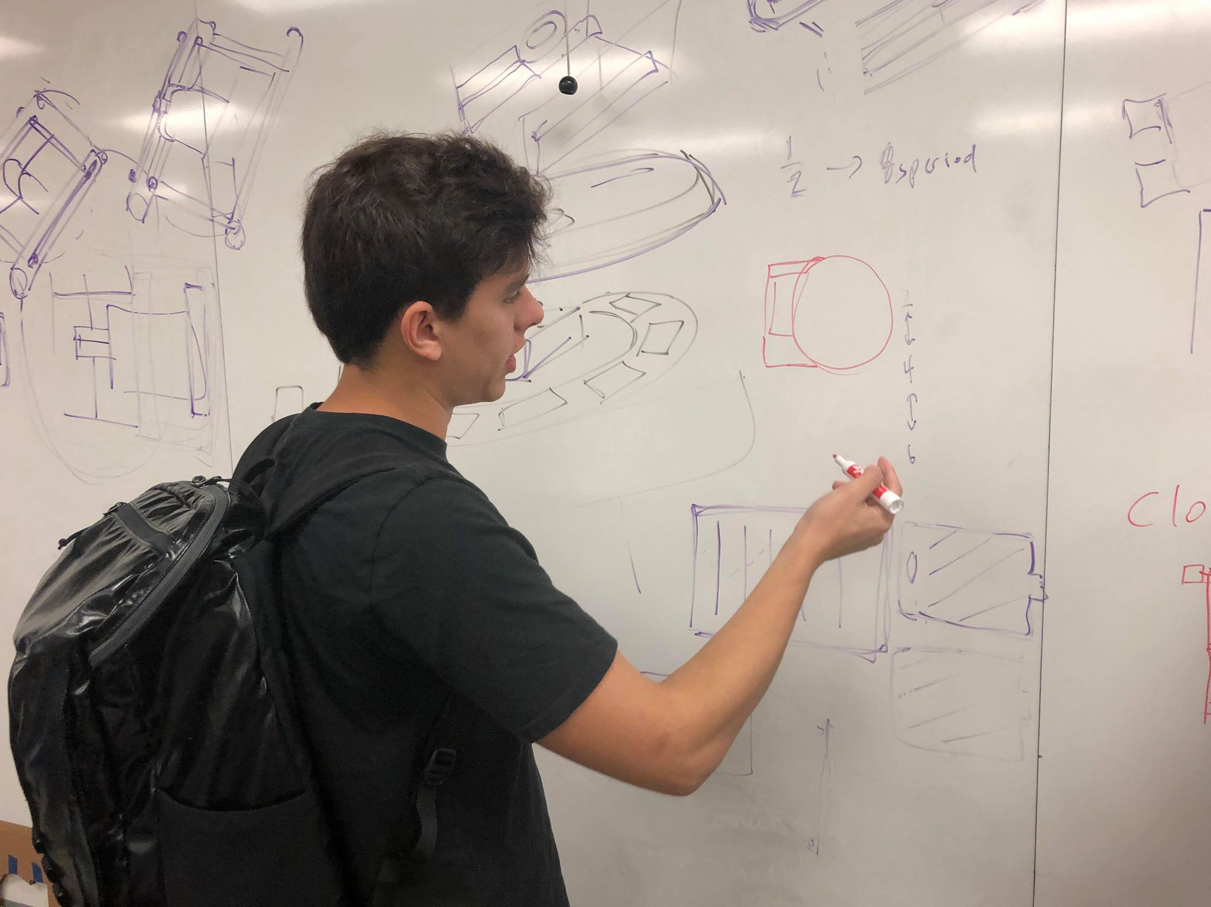
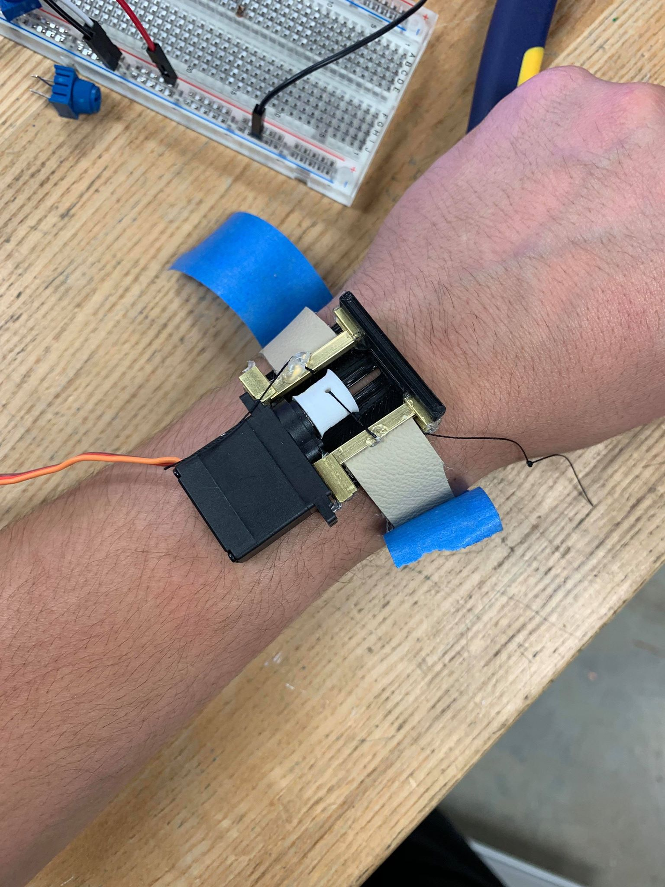
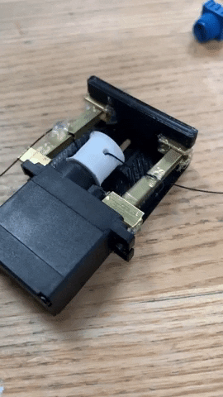
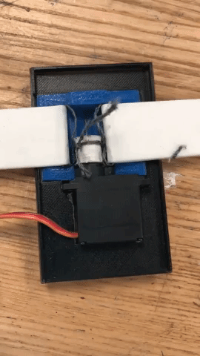
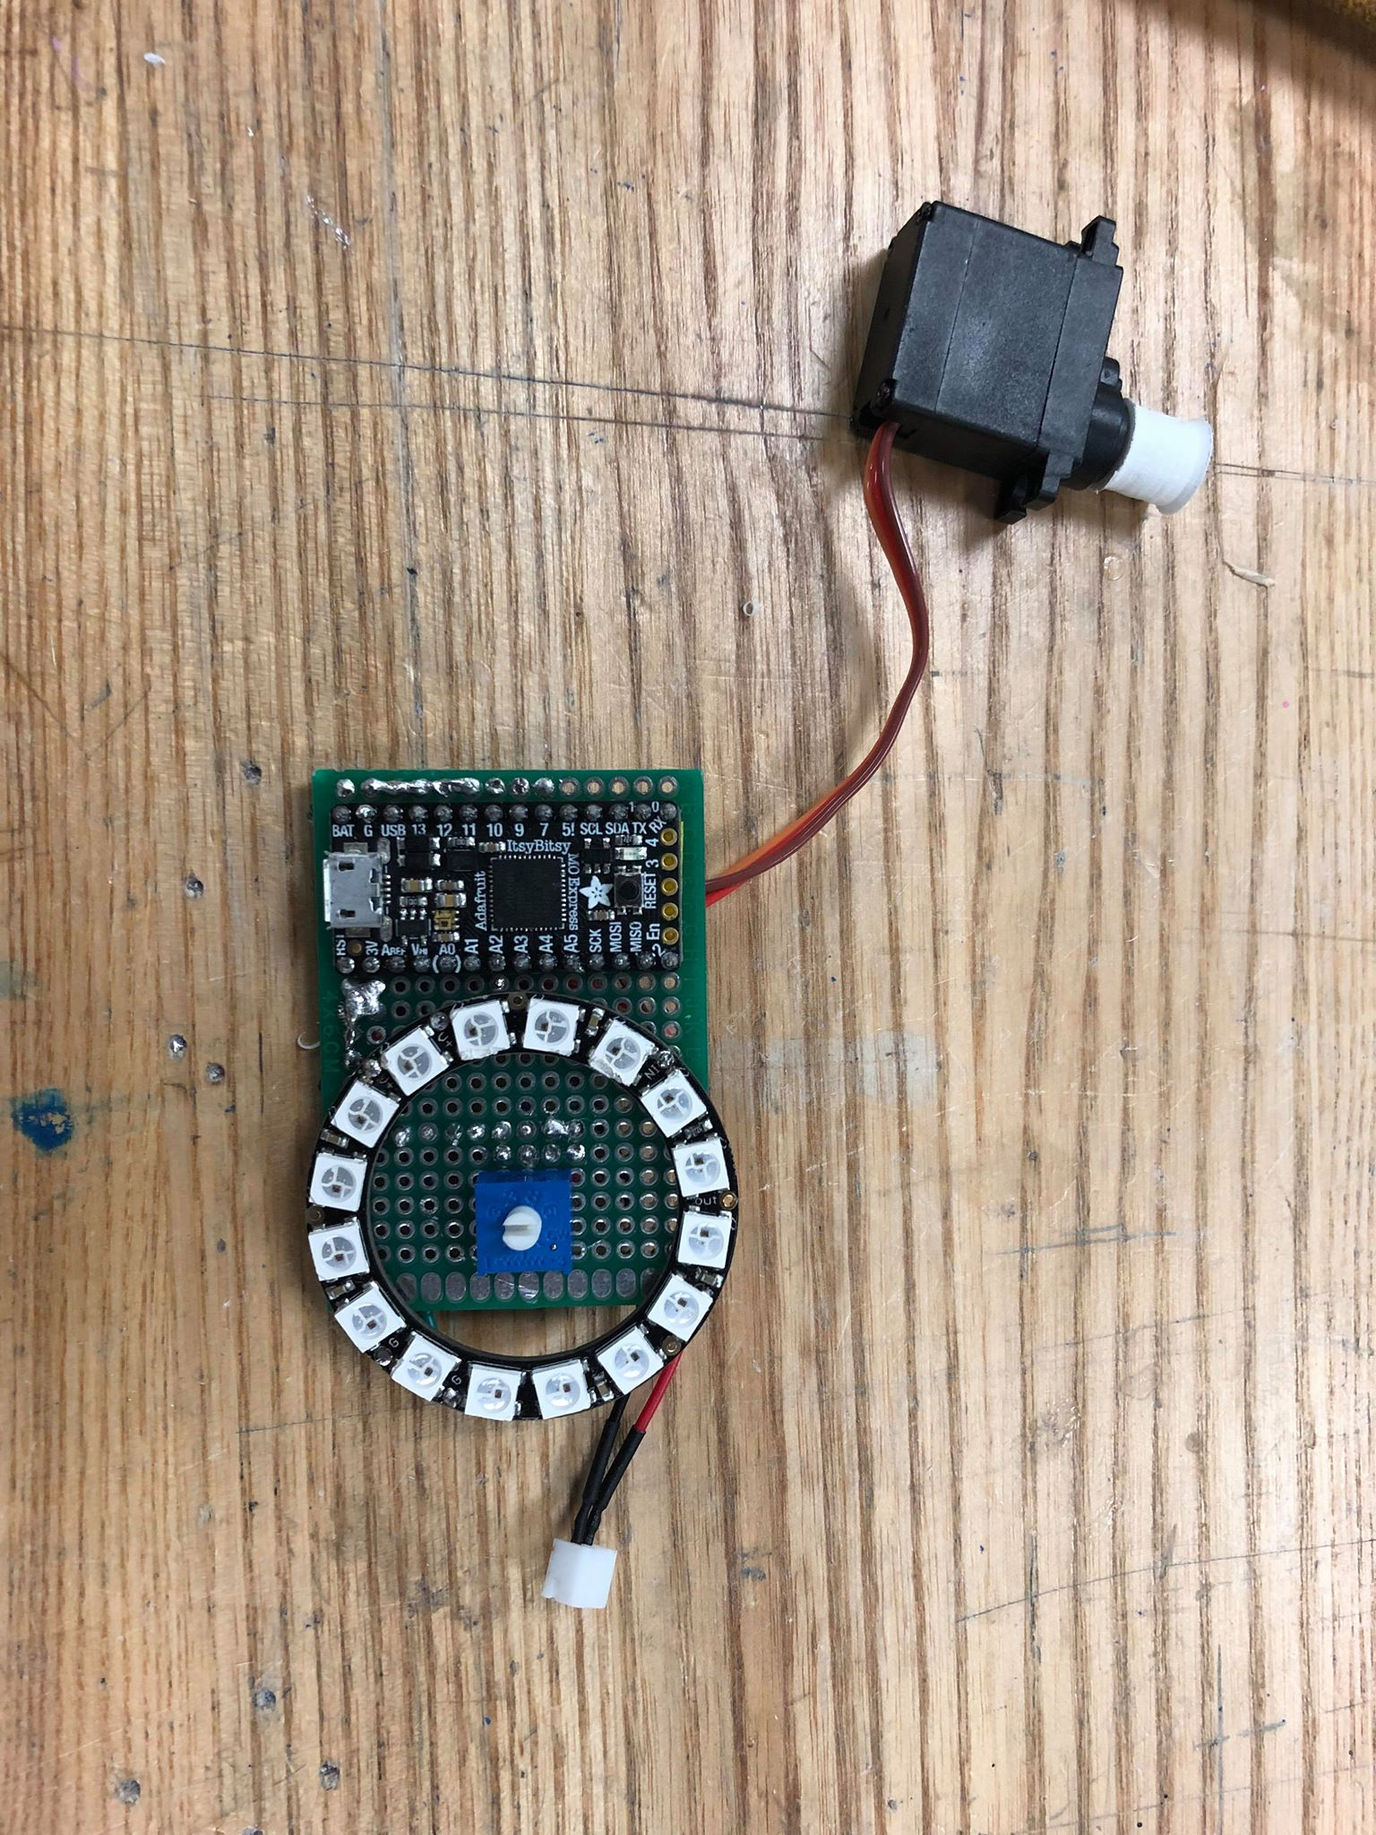
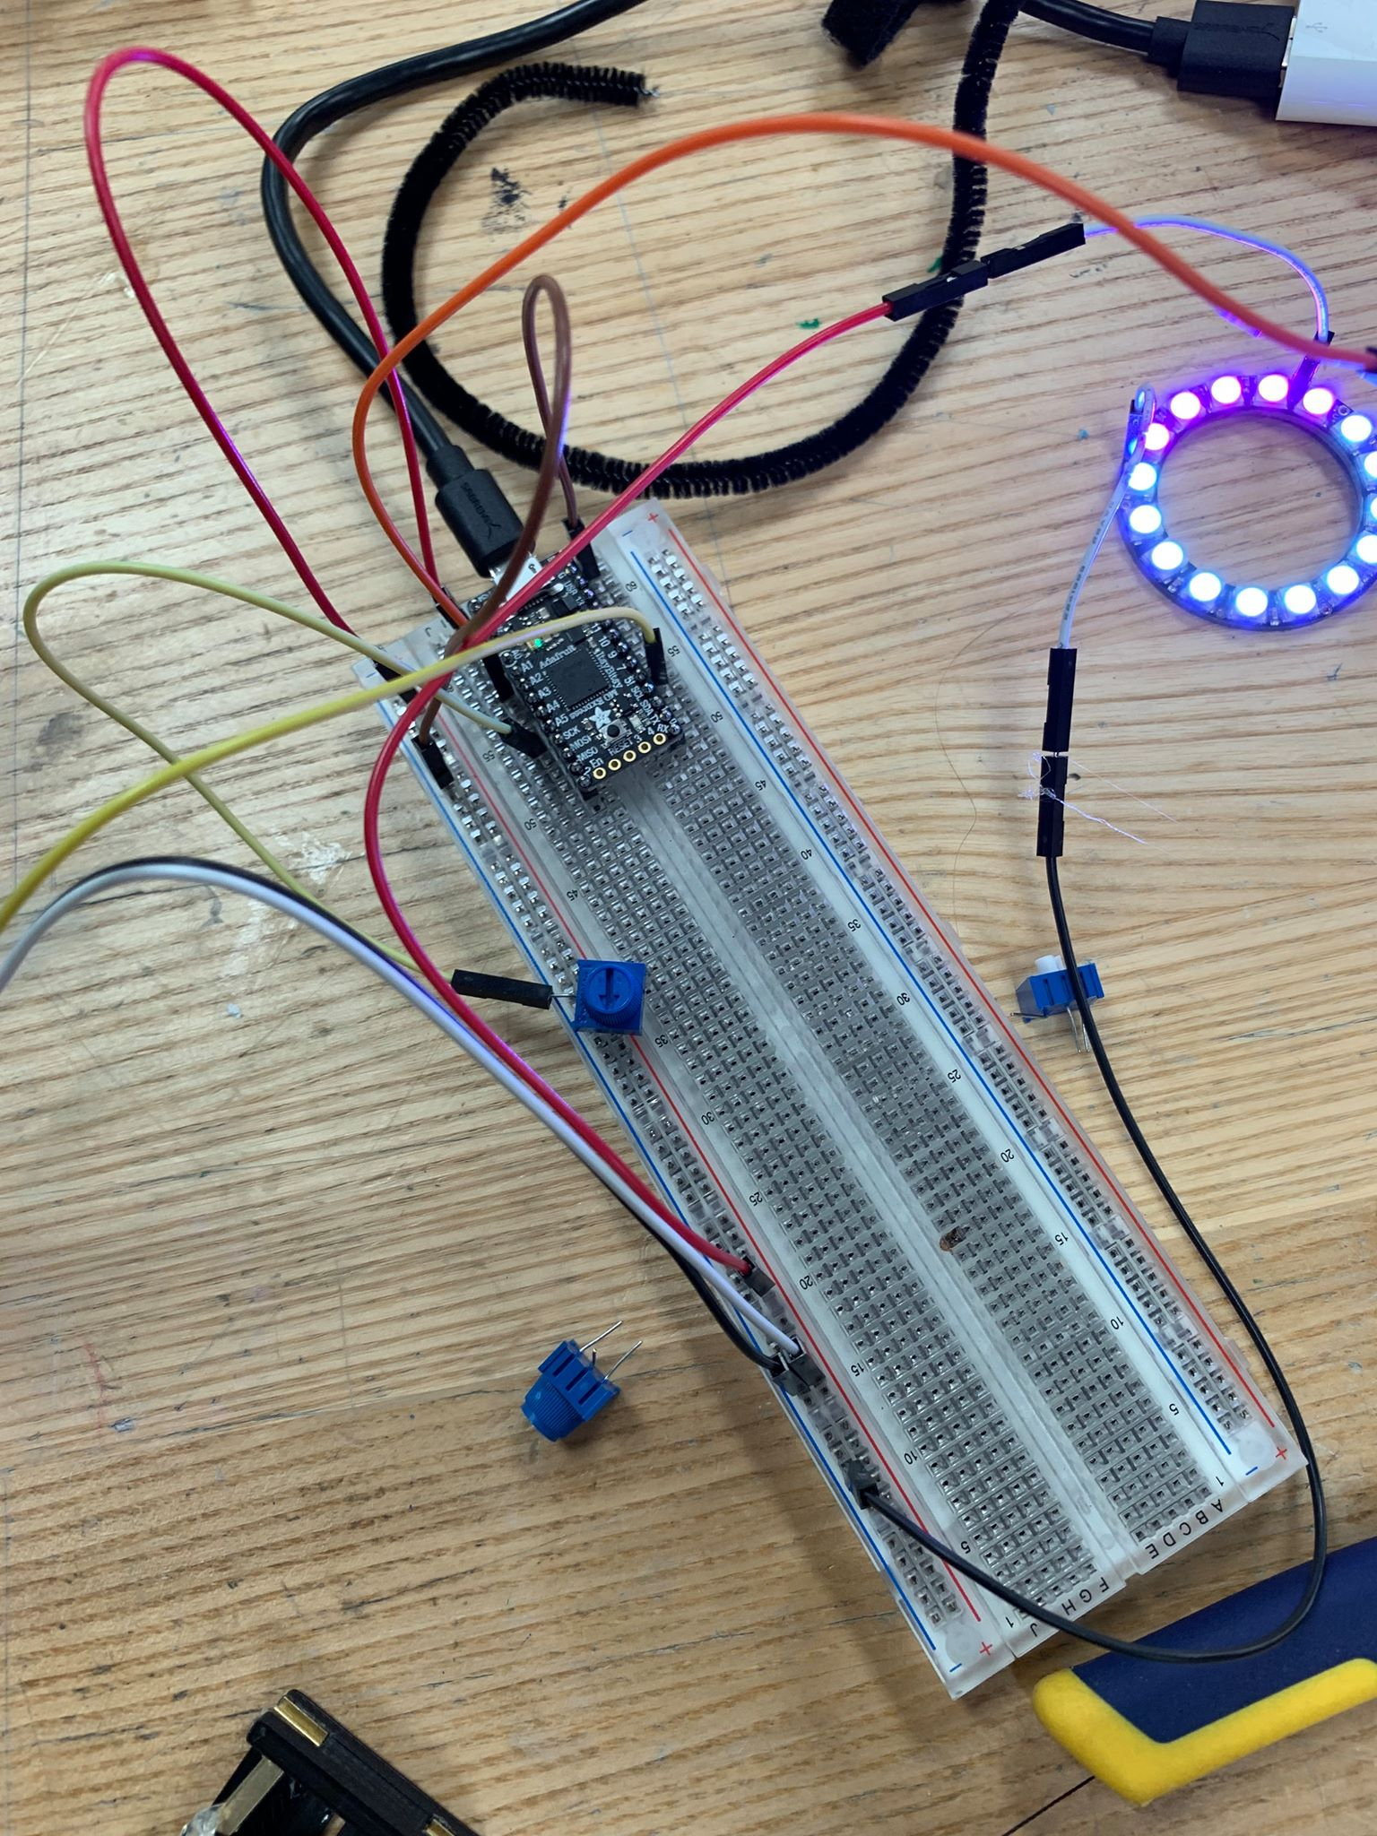
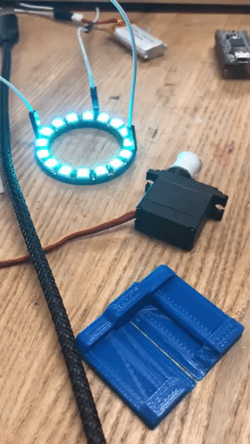
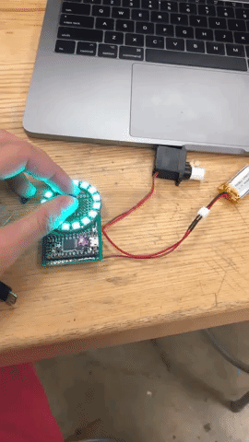
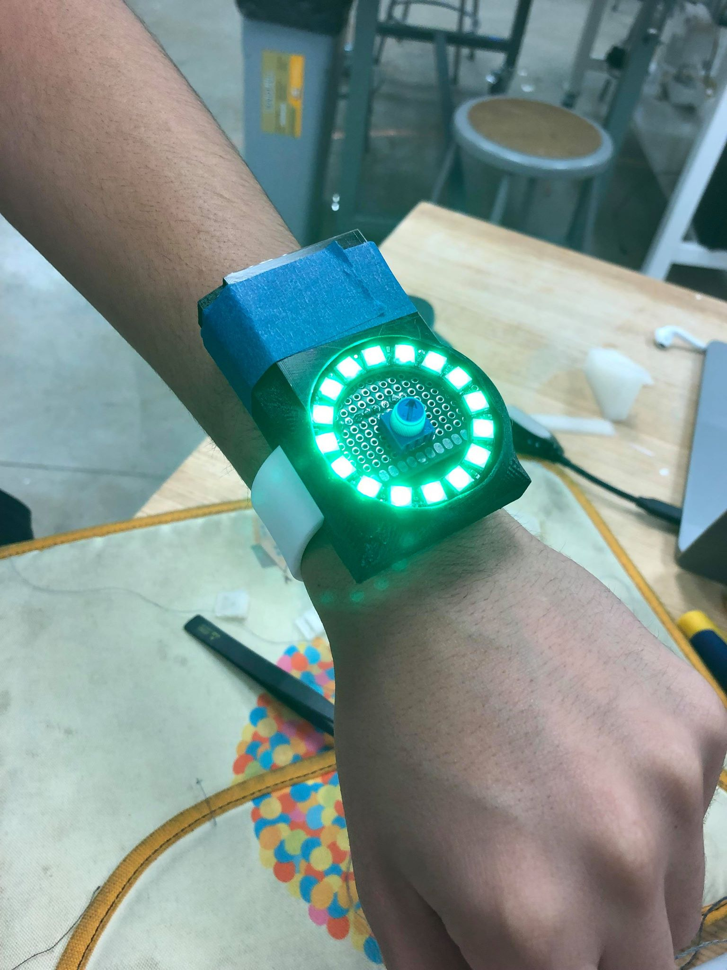
Notes:
oliver

Slide 11
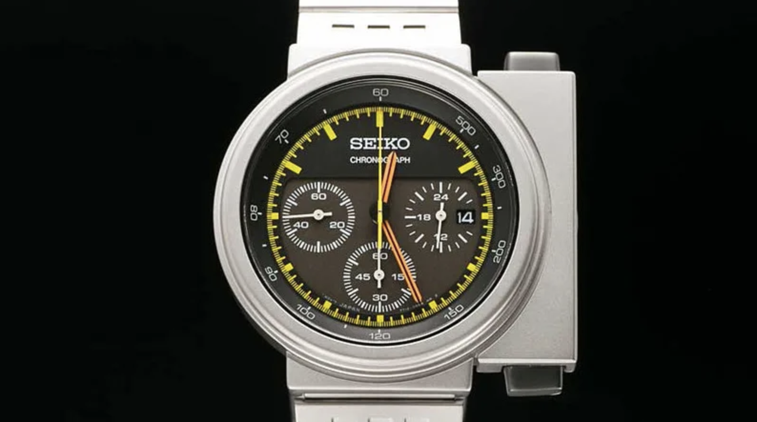
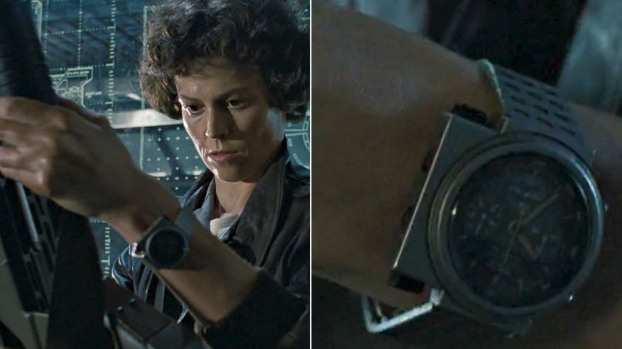
Notes:
Ridley Scott: ‘I wanted to scare the shit out of people. That’s the job’

Slide 12
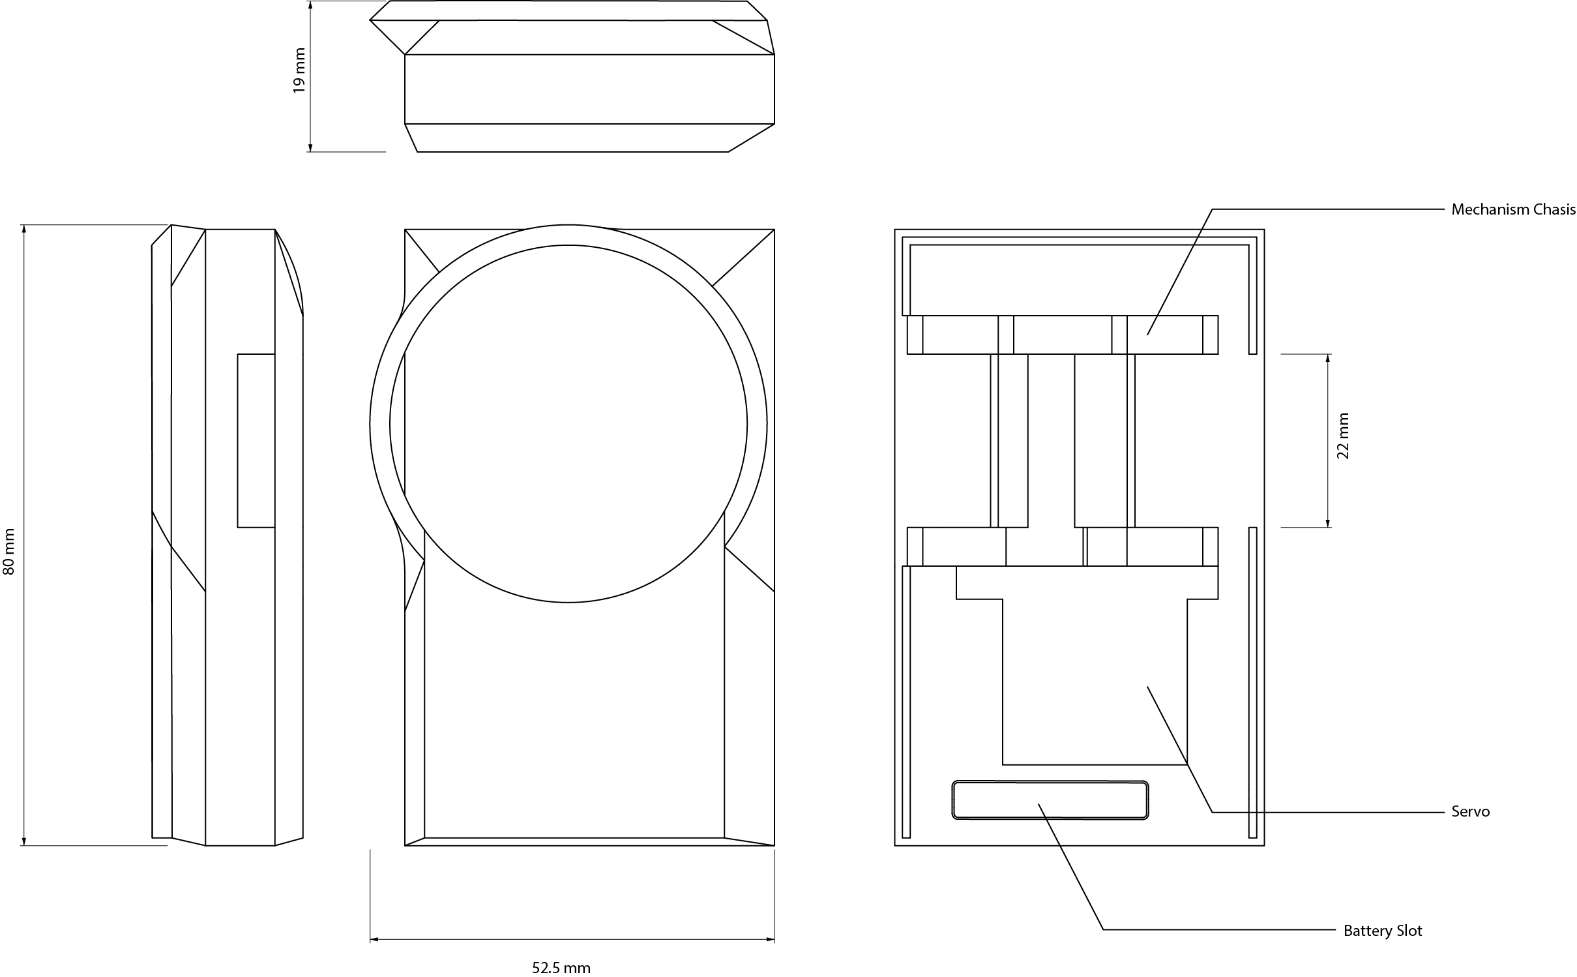

Slide 13
THE RESULT

Slide 14
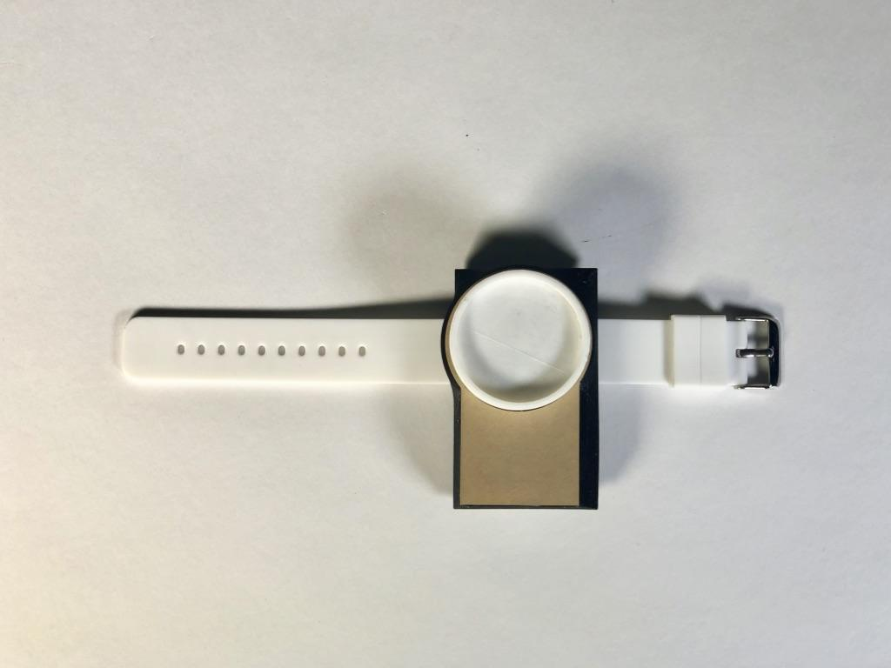
A wearable device to ground users in stressful times

Slide 15
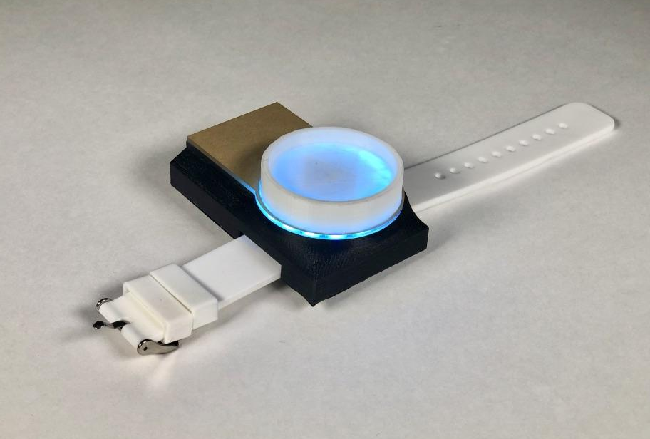
Turning the dial
Contracts and expands the band around the wrist, providing a calming and centering pattern
LED’s pulse to the pattern
Controls the pattern’s tempo

Slide 16
DEMO

Slide 17
VIDEO

Slide 18
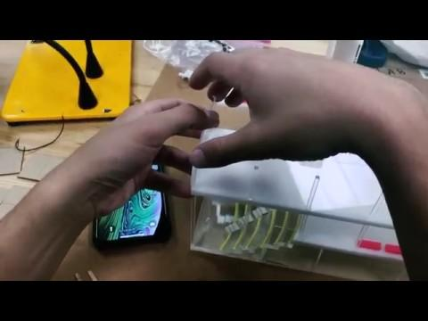

Slide 19
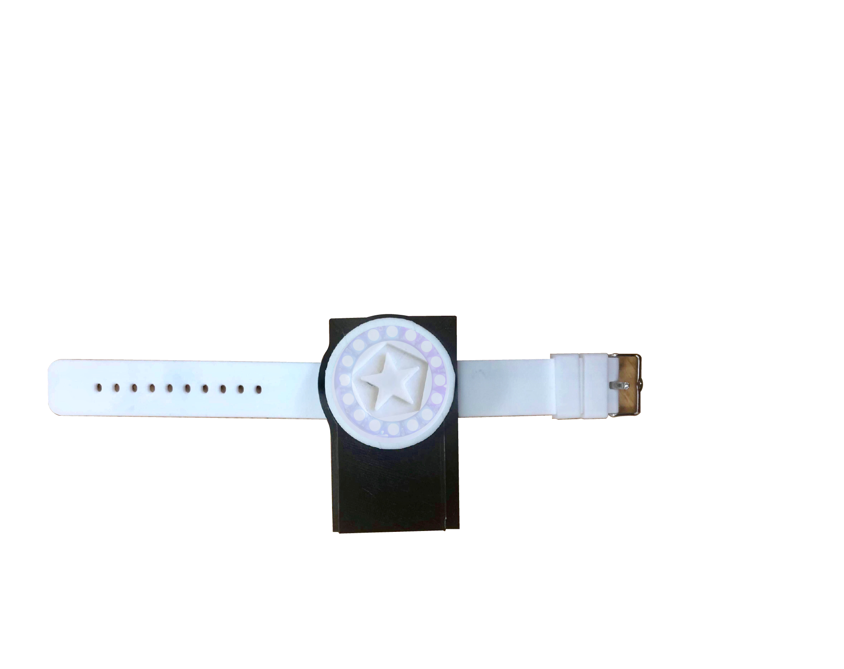
C a l m . i o
—Instant groundification

